Slide 1

ME23312 ENGINEERING THERMODYNAMICS
Unit III – Properties of Pure Substance · Presentation 4 of 10
The p–v–T Surface and the p–T Phase Diagram
Single-phase and two-phase regions · ruled surfaces · triple line and critical point · substances that contract or expand on freezing · the phase diagram
Dr. Anantha Raman L., M.E., Ph.D. · Associate Professor, Department of Mechanical Engineering, Rajalakshmi Institute of Technology, Chennai

Slide 2

In this presentation
Why a surface?
The p–v–T surface of a substance that contracts on freezing
Regions of the surface
Water – a substance that expands on freezing
The p–T (phase) diagram
The three curves and the triple point
ME23312 Engineering Thermodynamics · Unit III · Presentation 4
2

Slide 3
The p–v–T surface
1
ME23312 Engineering Thermodynamics · Unit III · Presentation 4
3

Slide 4
Why a surface?
Every equilibrium state of a pure substance is a point on a surface in p–v–T space – any two of the three properties fix the third
Two-dimensional projections are more convenient: p–T, p–v, T–v (and, with entropy, T–s and h–s)
The surface shows how all these diagrams fit together
ME23312 Engineering Thermodynamics · Unit III · Presentation 4
4

Slide 5
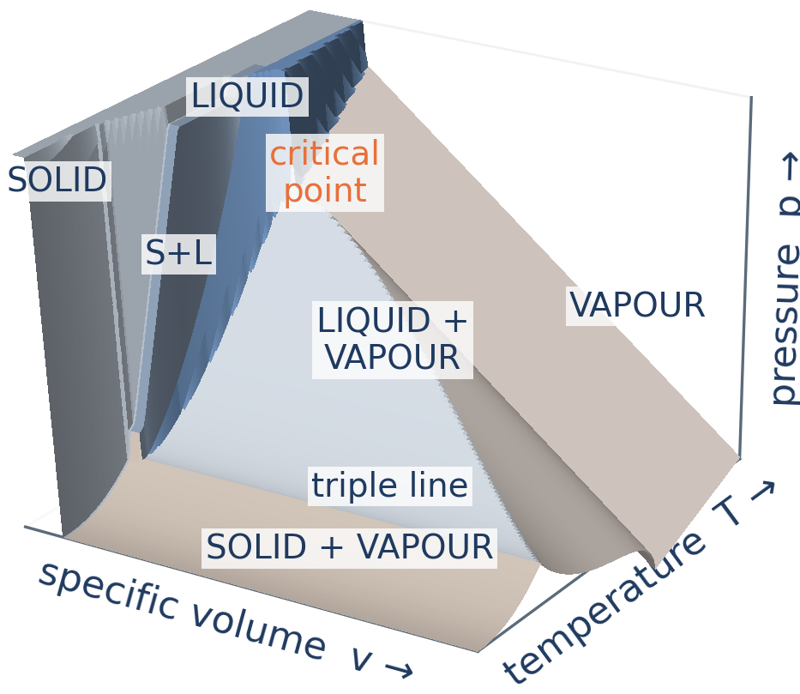
p–v–T surface: contraction on freezing
Three single-phase regions, three two-phase ruled surfaces, the triple line and the critical point
ME23312 Engineering Thermodynamics · Unit III · Presentation 4
5

Slide 6
Regions of the surface
Single-phase regions
Two-phase regions
Solid, liquid, vapour
p, v and T can all vary independently
Solid–liquid, liquid–vapour, solid–vapour
p and T are related – fixing one fixes the other; only v changes as the proportion of the phases changes
Ruled surfaces of straight lines of constant p and T – seen edge-on (as lines) along the v-axis
ME23312 Engineering Thermodynamics · Unit III · Presentation 4
6

Slide 7
Triple line and critical point
The three two-phase regions meet along the triple line
The liquid–vapour region narrows with increasing pressure and ends at the critical point
Above the critical point the liquid and vapour regions merge
ME23312 Engineering Thermodynamics · Unit III · Presentation 4
7

Slide 8
Water – expansion on freezing
2
ME23312 Engineering Thermodynamics · Unit III · Presentation 4
8

Slide 9
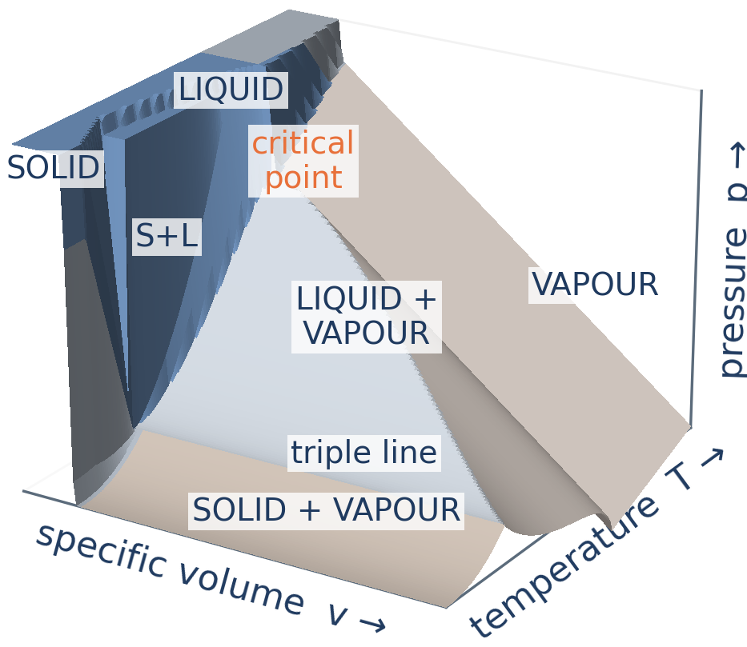
p–v–T surface of water: expansion on freezing
The solid has the larger volume, so the solid–liquid region leans the other way
ME23312 Engineering Thermodynamics · Unit III · Presentation 4
9

Slide 10
Contraction versus expansion on freezing
Most substances contract
Water expands
Solid denser than the liquid
Solid–liquid surface at smaller volumes than the liquid
Fusion curve on the p–T plane slopes to the right – melting point rises with pressure
Ice floats – the solid has the larger volume
Solid–liquid region leans the other way
Fusion curve has a negative slope – the melting point of ice falls as pressure rises: ice under a skate blade melts
ME23312 Engineering Thermodynamics · Unit III · Presentation 4
10

Slide 11
The p–T phase diagram
3
ME23312 Engineering Thermodynamics · Unit III · Presentation 4
11

Slide 12
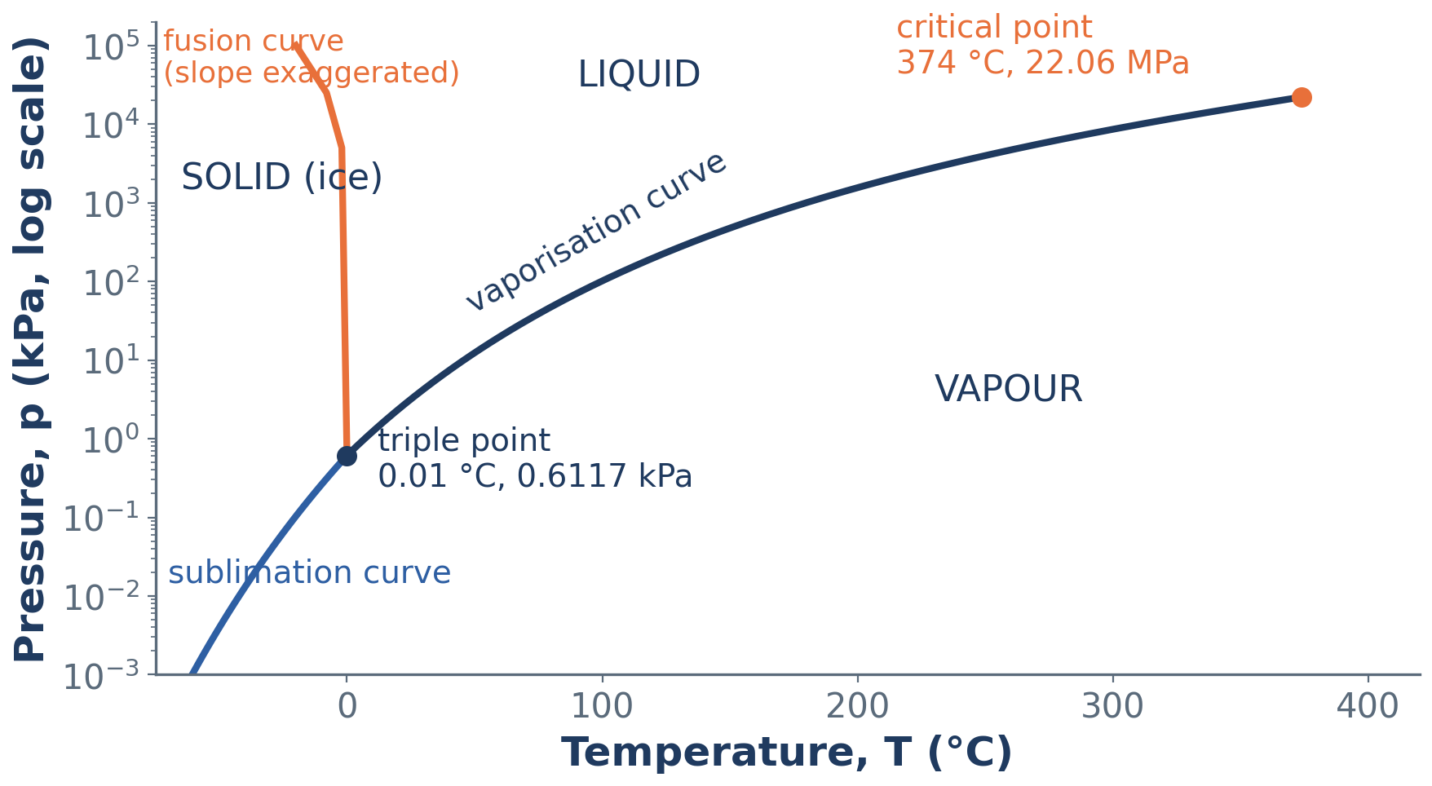
The p–T (phase) diagram of water
Each two-phase region of the surface collapses into a single curve; the three curves meet at the triple point
ME23312 Engineering Thermodynamics · Unit III · Presentation 4
12

Slide 13
The three curves
Vaporisation curve
Fusion curve
Sublimation curve
Vapour-pressure curve separating liquid from vapour; ends at the critical point.
Separates solid from liquid; negative slope for water (exaggerated in the figure).
Separates solid from vapour below the triple point.
ME23312 Engineering Thermodynamics · Unit III · Presentation 4
13

Slide 14
Why the phase diagram is useful
Shows at a glance which phase exists at any p and T
The three curves meet at the triple point
The diagram on which the Clausius–Clapeyron equation (Unit IV) is written
ME23312 Engineering Thermodynamics · Unit III · Presentation 4
14

Slide 15
Summary
p–v–T surface: any two properties fix the third; diagrams are its projections
Single-phase regions: solid, liquid, vapour; two-phase regions: ruled surfaces with p and T linked
Triple line where the three two-phase regions meet; critical point ends the liquid–vapour region
Water expands on freezing – its fusion curve has a negative slope
p–T diagram: vaporisation, fusion and sublimation curves meeting at the triple point
Tells which phase exists at any p and T
ME23312 Engineering Thermodynamics · Unit III · Presentation 4
15

Slide 16
Next: The p–v, T–s and h–s diagrams
The saturation dome and isotherms on the p–v plane
The T–s diagram – heat as an area
The Mollier (h–s) chart and how to read it
ME23312 Engineering Thermodynamics · Unit III · Presentation 4
16

